Slide 1
Business Process Modeling and Optimization under Resource Constraints
PROJECT EVALUATION
Indian Institute of Information Technology, Allahabad
Notes:
Intro: topic hai Business Process Modeling aur Optimization under Resource Constraints. Ek line me: kisi process ko model karke limited resources (log, machines, budget) ko best tareeke se allocate karna. Flow: pehle problem, phir solution, ek chhota example, cost vs time trade-off, related papers, aur end me abhi tak ka progress aur next steps.

Slide 2
Business Process Modeling and Optimization under Resource Constraints
PROBLEM STATEMENT
A business process is a chain of tasks that need limited resources: people, machines and budget. When demand is higher than capacity, waiting time and cost grow. We must model the process and decide how to allocate resources within the limits.
Limited resources
Cost vs time
Trial and error
Few staff, machines or budget for many cases, so tasks queue up and wait.
More resources cut cycle time but raise cost. The two goals pull in opposite directions.
Analysts change allocations by hand and cannot test every combination.
BPM evaluation · 2 / 7
Notes:
Problem simple hai: kisi bhi process (jaise bank loan approval, hospital, delivery) me tasks hote hain jinko karne ke liye limited resources chahiye hote hain - log, machines, budget. Demand zyada aur resources kam ho to cases queue me wait karte hain, cycle time badhta hai aur cost bhi. Teen main dikkatein: (1) resources limited hain, (2) cost aur time ek doosre ke against kaam karte hain - resources badhao to time kam hota hai par cost badhti hai, (3) analyst manually try karta hai, saare combinations test karna possible nahi. Isliye humein process ko model karke best resource allocation nikalna hai, constraints ke andar.

Slide 3

Model, simulate, optimise, evaluate
PROPOSED SOLUTION
01
02
03
04
Model
Simulate
Optimise
Evaluate
Draw the as-is process in BPMN with tasks, roles and rules.
Run simulation with arrival rates, task times and resource calendars.
Search for the best resource allocation within the limits.
Compare to-be with as-is on waiting time, cost and utilisation.
Constraints we respect
What we optimise
Headcount per role, working hours and calendars, budget cap, and the skills of each resource.
Cycle time and cost together, giving a Pareto set of allocations to choose from. Method: NSGA-II, a multi-objective genetic algorithm.
BPM evaluation · 3 / 7
Notes:
Solution ka flow: (1) Model - process ko BPMN me draw karo, tasks, roles aur rules ke saath. (2) Simulate - arrival rate, task duration, resource calendars daal ke simulation chalao, isse bottleneck dikhta hai (jahan utilisation zyada aur waiting zyada). (3) Optimise - constraints ke andar best allocation dhoondo. Constraints: har role ke kitne log, working hours, budget cap, skills. Objective: cycle time aur cost dono kam karna. Dono conflict karte hain isliye ek single answer nahi milta, Pareto set milta hai (trade-off options). Method: NSGA-II, ek multi-objective genetic algorithm. Ye population of allocations banata hai, simulation se har ek ka cost aur time naapta hai, aur best trade-offs aage badhata hai. Reinforcement learning aur hill climbing future work / alternatives hain. (4) Evaluate - to-be ko as-is se compare karo waiting time, cost, utilisation par. Agar poocha jaye: ek chhota example process (3-4 tasks, 2-3 roles) leke ye dikha sakte hain.

Slide 4

Loan approval: four tasks, three roles
WORKED EXAMPLE
Receive application
Check documents
Assess risk
Approve
Role: Clerk
Role: Clerk
Role: Analyst
Role: Manager
Clerk
Analyst
Manager
Many are needed and each is cheap. Handles intake and document checks.
Risk assessment takes the longest, so queues build up here.
Few people and the highest cost. Gives the final approval.
How many clerks, analysts and managers do we need? With 1 to 5 people per role there are already 125 combinations, and real processes have far more.
Illustrative setup, not real data · BPM evaluation · 4 / 7
Notes:
Ye ek simple example hai taaki idea clear ho jaye. Loan approval me 4 tasks hain: application receive karna, documents check karna, risk assess karna, aur approve karna. 3 roles hain: clerk, analyst, manager. Sawal ye hai ki har role ke kitne log rakhein. Agar har role ke 1 se 5 log ho sakte hain to 5 x 5 x 5 = 125 combinations ho gaye. Real process me tasks aur roles zyada hote hain, isliye har combination manually test karna possible nahi. Isiliye simulation aur optimisation chahiye. Ye example sirf samjhane ke liye hai, real data nahi hai - ye clearly bol dena.

Slide 5
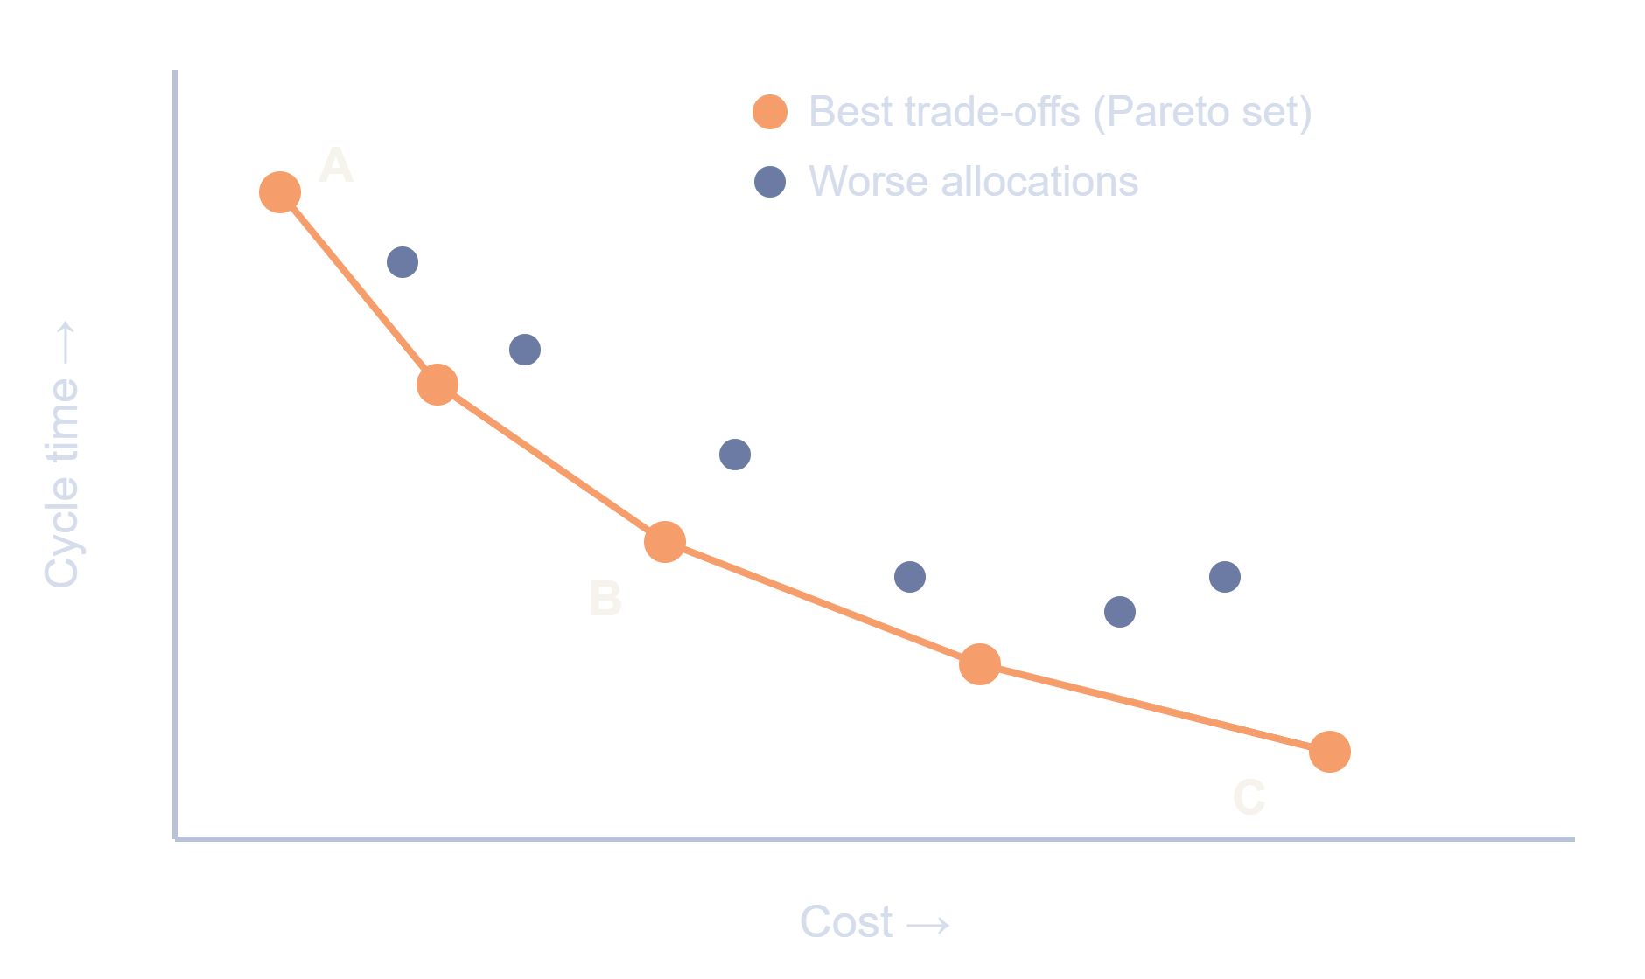
Cost and cycle time conflict
TRADE-OFF
A: lowest cost
Few staff, longest waiting time.
B: balanced
A middle path between cost and speed.
C: fastest
Shortest cycle time, highest cost.
The optimiser returns the whole set. The decision maker picks the point that fits the budget.
Illustrative sketch of the idea, not measured results · BPM evaluation · 5 / 7
Notes:
Ye chart illustrative sketch hai, measured result nahi - ye clearly bolna. Idea: har point ek resource allocation hai. X axis par cost, Y axis par cycle time. Kuch allocations doosron se strictly worse hain (zyada slow aur zyada costly) - ye grey points hain. Orange points best trade-offs hain, inhe Pareto set kehte hain. A sabse sasta par slow hai, C sabse fast par mehnga, B beech ka. NSGA-II ye poora set deta hai, aur decision maker apne budget ke hisaab se point chunta hai. Agar poocha jaye NSGA-II kyun: kyunki ye multi-objective hai aur ek hi run me poora trade-off set de deta hai, jabki weighted sum se sirf ek answer milta hai.

Slide 6
Papers linked to the problem statement
RELATED RESEARCH
Paper | Venue, year | What it contributes
Automatic Resource Allocation in Business Processes: A Systematic Literature Survey | arXiv, 2021 | Maps goals and methods; rule-based approaches dominate
Discovering optimal resource allocations for what-if scenarios using data-driven simulation | Frontiers in Comp. Sci., 2023 | Event logs, simulation and NSGA-II multi-objective search
Optimos: A Tool for Simulation-Driven Business Process Optimization | CEUR-WS Vol. 3758 | Explores allocations and timetables under user constraints
Our approach builds on these: simulation plus multi-objective search · BPM evaluation · 6 / 7
Notes:
Ye papers Google Scholar par title search karke mil jayenge. Sabse pehle survey (Pufahl et al.) padh lo - usme pura overview hai ki resource allocation ke kaun kaun se approaches hain (rule-based, heuristics, learning). Frontiers 2023 - event logs se simulation model bana kar NSGA-II se multi-objective optimal allocation (hamare solution se seedha match). Optimos - tool jo BPMN model + constraints leke allocation aur timetable explore karta hai. Evaluation me bas itna bolna kaafi hai: problem kya hai, kaun se approaches hain (simulation + heuristics/GA/RL), aur hum konsa approach lenge.

Slide 7
Where the project stands
PROGRESS AND NEXT STEPS
DONE
NEXT
LATER
Problem scoped, with objectives and constraints
Literature surveyed, 3 key papers mapped
Method chosen: BPMN, simulation, NSGA-II
Model a toy process, such as loan approval
Write a small simulator in C++
Try resource allocations on the toy process
Run NSGA-II to get the Pareto set
Extend to a real event log
Compare with hill climbing and reinforcement learning
The problem and method are settled. The next step is turning them into measured results.
BPM evaluation · 7 / 7
Notes:
Honest status batana hai. Done: problem define kiya, objectives (cycle time aur cost) aur constraints (headcount, working hours, budget, skills) tay kiye, literature survey kiya (3 key papers), aur method choose kiya: BPMN model, simulation, aur NSGA-II optimisation. Next: ek toy process (loan approval) model karna, chhota simulator likhna, aur uspar resource allocations try karna. Later: NSGA-II se Pareto set nikalna, real event log par extend karna, aur hill climbing aur reinforcement learning se compare karna. Agar poocha jaye ki implementation ho gaya kya: abhi nahi, design aur literature complete hai, prototype agla step hai. Ye sach bolna better hai, panel ko clear plan dikhna chahiye.

